Slide 1
Hot Jupiter
2022311224 이진진

Slide 2
01
02
03
04
Hot Jupiter
Two different
planets
Detect with HST
Limitation

Slide 3
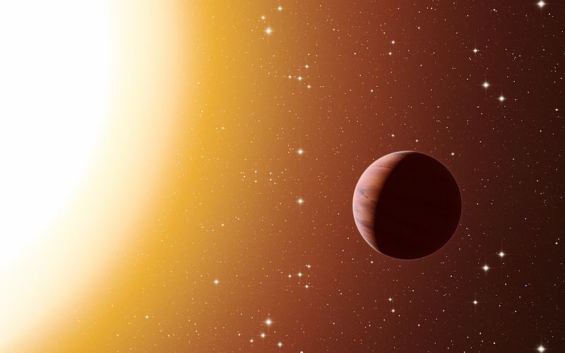
01
Hot Jupiter
- Exoplanet (orbiting another star outside the solar system)
- Orbits a very close distance from the star (less than 0.1 AU)
→ very short orbital periods (P < 10 days)
- Giant gas planet with a Jupiter mass
- Surface temperature will be very hot
(due to the radiation energy of the intense star)

Slide 4
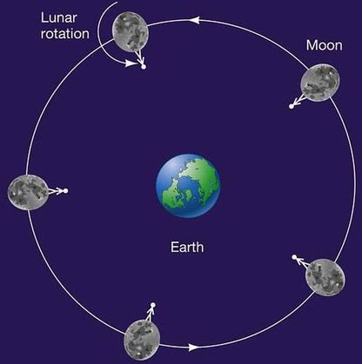
01
Hot Jupiter

Slide 5
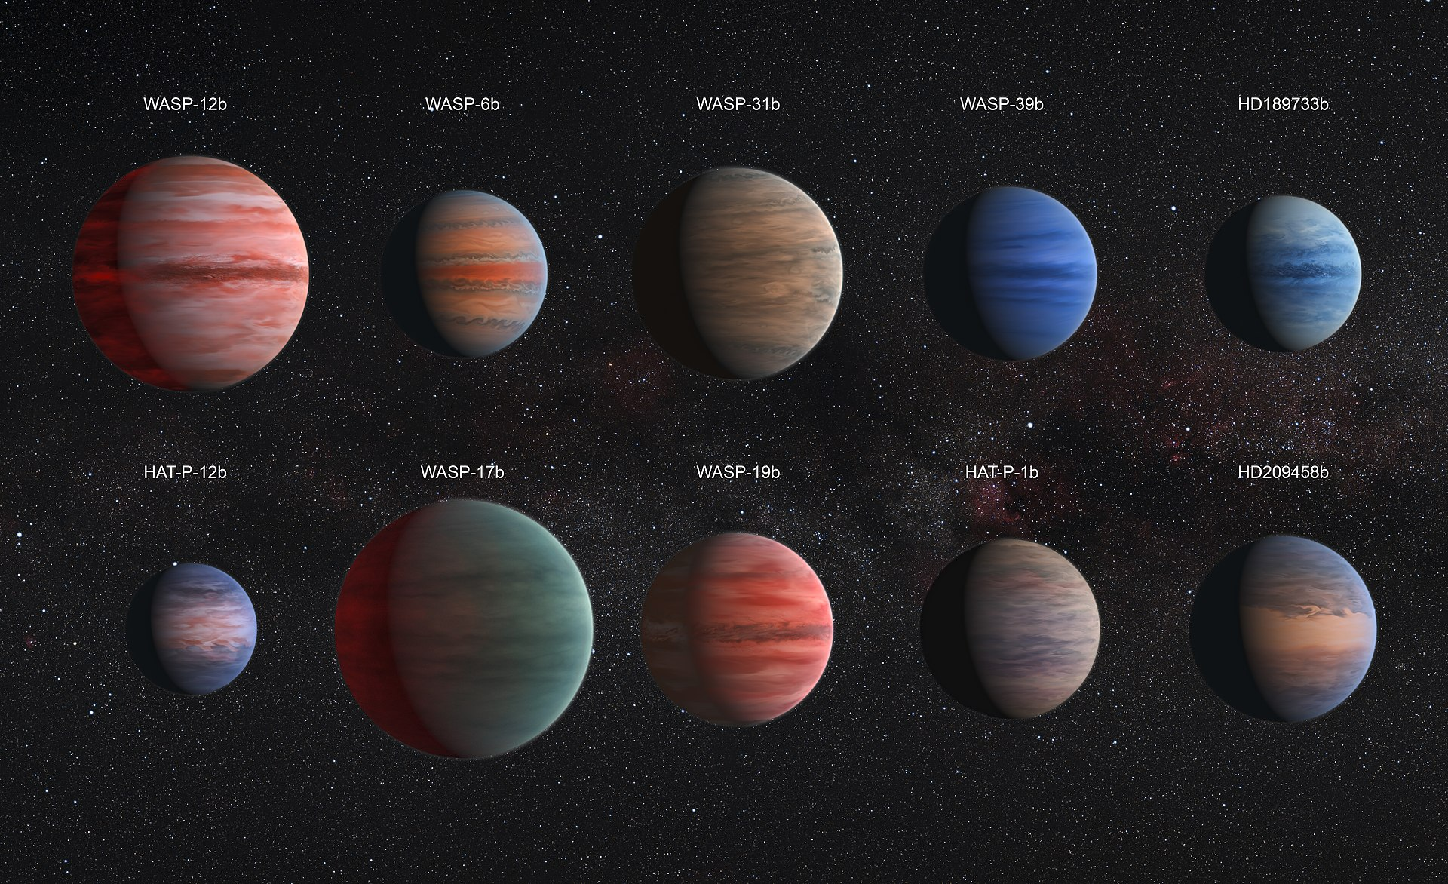
01
Hot Jupiter

Slide 6
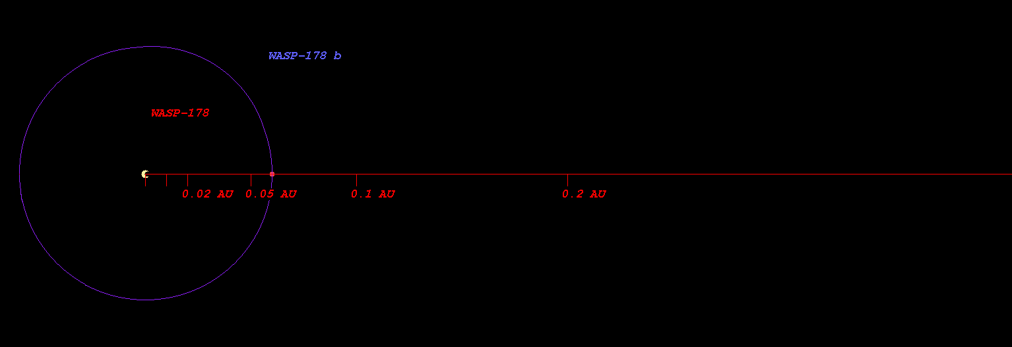
01
Hot Jupiter

Slide 7
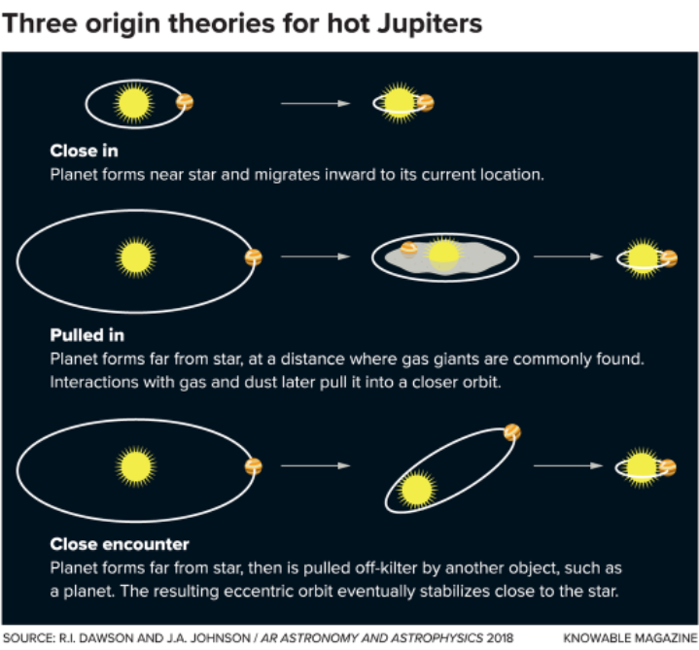
01
Hot Jupiter

Slide 8
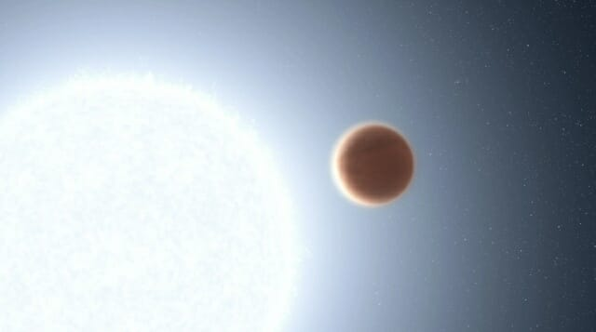
02
Two different planets
WASP-178b
Kelt-20b
The hottest and Extreme Environmental
exoplanets ever observed
Picture of Kelt-20b

Slide 9
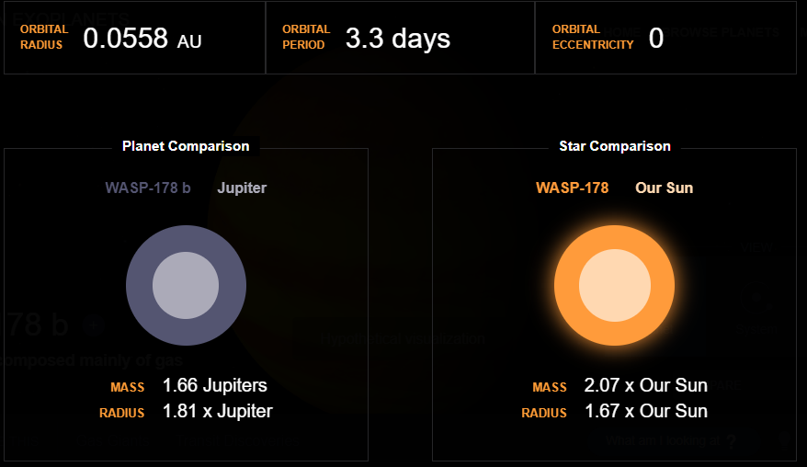
02
Two different planets
1. Wasp178b
- The planet is fixed day and night by region.
The daytime atmosphere :
Silicon monoxide is densely concentrated in
(speed of more than 3200 kilometers per hour)
The night-time atmosphere :
Surface has a relatively low temperature
→ so the clouded silicon monoxide into a liquid
causing rock rain.

Slide 10
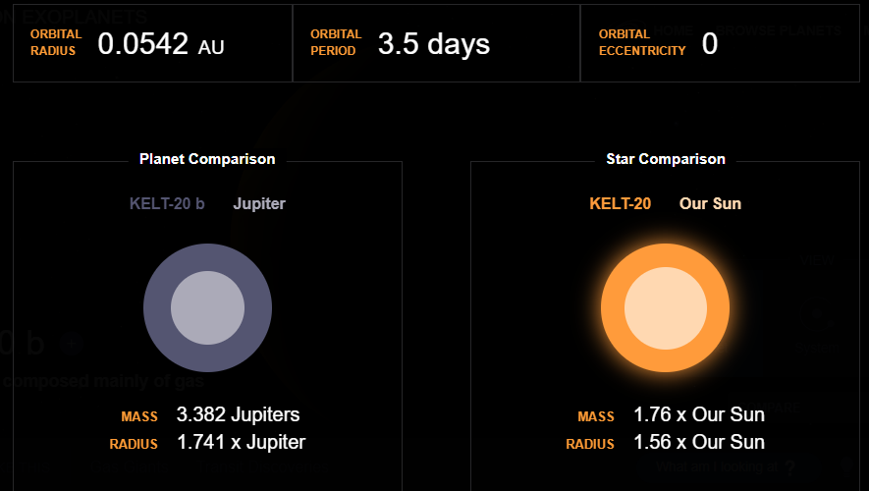
02
Two different planets
1. Kelt-20b
Absorbs Intense ultraviolet radiation from sun
↓
planet's upper atmosphere become high temp

Slide 11
Exoplanet | WASP-178 b | Kelt-20b
Radius | 1.9400 R(Jup) / 21.7455 R(Earth) | 1.8300 R(Jup) / 20.5125 R(Earth)
Mass | 1.4100 M(Jup) / 448.2926 M(Earth) | 3.5180 M(Jup) / 1118.5059 M(Earth)
Semi Major Axis (Orbital Distance) | 0.0558 AU | 0.0542 AU
Eccentricity | 0.0000 | 0.0000
Orbital Period | 3.34 days | 3.47 days
Surface Gravity | 0.9480 G(Earth) | 2.6583
Star Radiation at Atmospheric Boundary | 7118997.0 W/m^2 | 6949467.8 W/m^2
Blackbody T 0.1 | 2305.4 K | 2291.6 K
Blackbody T 0.3 | 2165.0 K | 2152.0 K
Blackbody T 0.7 | 1751.7 K | 1741.2 K
Star Distance | 1395 LY | 445LY
Stellar Radius | 1.8 R(Sun) | 1.6 R(Sun)
Stellar Mass | 1.9 M(Sun) | 1.9 M(Sun)
Star Age | 0.4 GY | 0.2 GY
Temperature | 8640 K | 8980 K
Spectral type | A1IV-V | A2
UV portion | 7.8 % | 7.8 %
Visible portion | 44.8 % | 44.8 %
IR portion | 47.4 % | 47.4 %
Metallicity | -0.1 | -0.0
Absolute Magnitude | 1.8 | 25.0
Apparent Magnitude | 9.9 | 3.0
Exoplanet | WASP-178 b | Kelt-20b
Radius | 1.9400 R(Jup) / 21.7455 R(Earth) | 1.8300 R(Jup) / 20.5125 R(Earth)
Mass | 1.4100 M(Jup) / 448.2926 M(Earth) | 3.5180 M(Jup) / 1118.5059 M(Earth)
Semi Major Axis (Orbital Distance) | 0.0558 AU | 0.0542 AU
Eccentricity | 0.0000 | 0.0000
Orbital Period | 3.34 days | 3.47 days
Surface Gravity | 0.9480 G(Earth) | 2.6583
Star Radiation at Atmospheric Boundary | 7118997.0 W/m^2 | 6949467.8 W/m^2
Blackbody T 0.1 | 2305.4 K | 2291.6 K
Blackbody T 0.3 | 2165.0 K | 2152.0 K
Blackbody T 0.7 | 1751.7 K | 1741.2 K
Star Distance | 1395 LY | 445LY
Stellar Radius | 1.8 R(Sun) | 1.6 R(Sun)
Stellar Mass | 1.9 M(Sun) | 1.9 M(Sun)
Star Age | 0.4 GY | 0.2 GY
Temperature | 8640 K | 8980 K
Spectral type | A1IV-V | A2
UV portion | 7.8 % | 7.8 %
Visible portion | 44.8 % | 44.8 %
IR portion | 47.4 % | 47.4 %
Metallicity | -0.1 | -0.0
Absolute Magnitude | 1.8 | 25.0
Apparent Magnitude | 9.9 | 3.0
03
Detect with HST

Slide 12
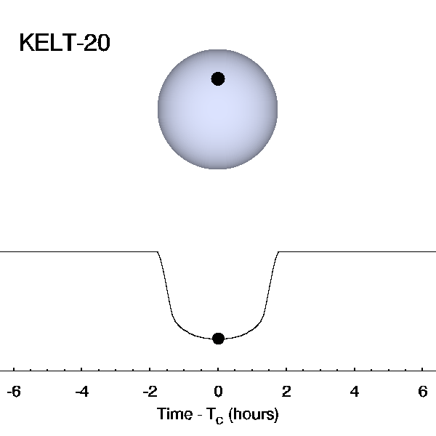
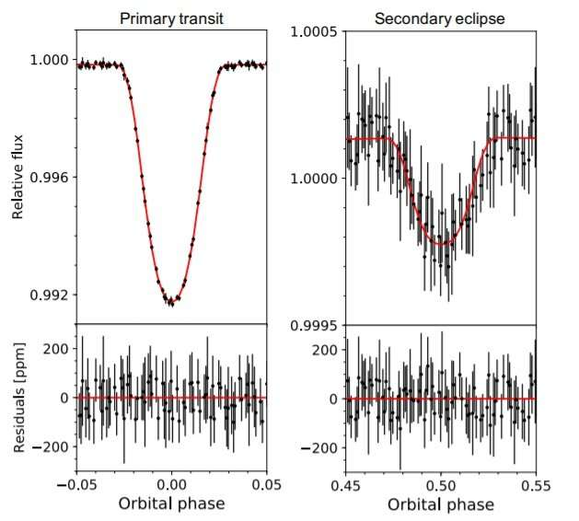
03
Detect with HST
Exoplanet | WASP-178 b | Kelt-20b
Detection Type : | Primary Transit
Mass Detection : | Radial Velocity
Radius Detection : | Primary Transit

Slide 13
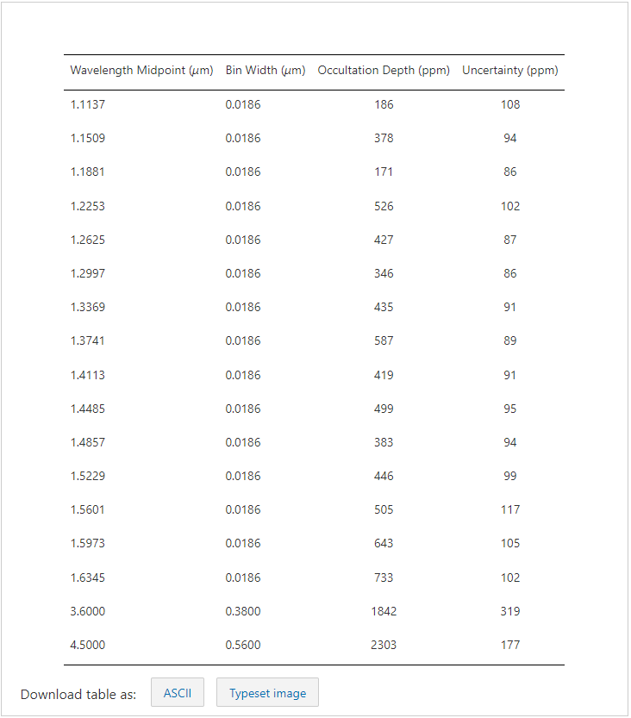
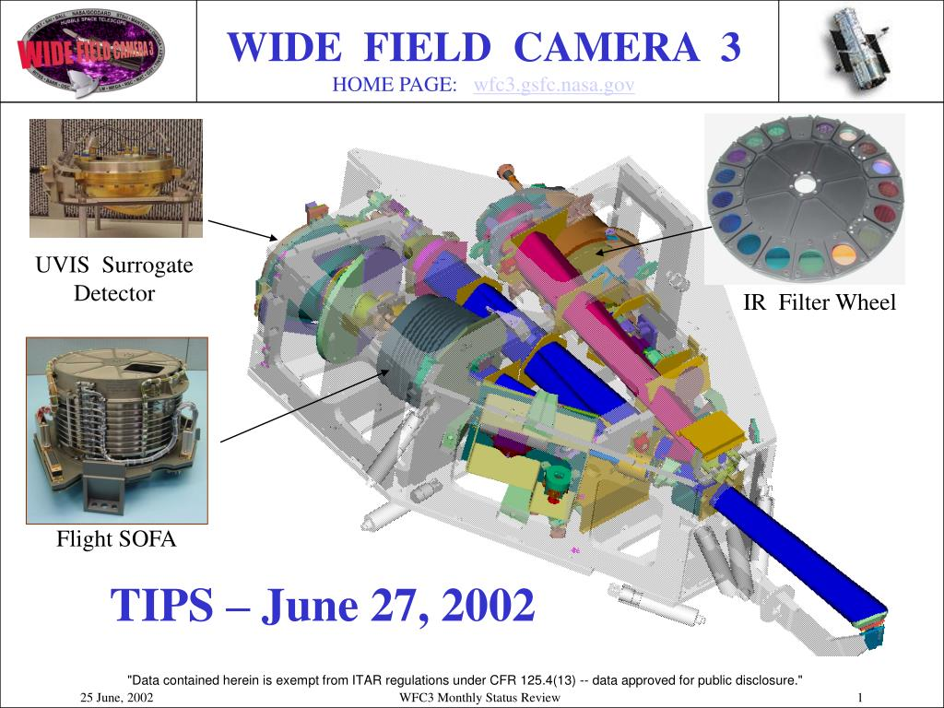
03
Detect with HST

Slide 14
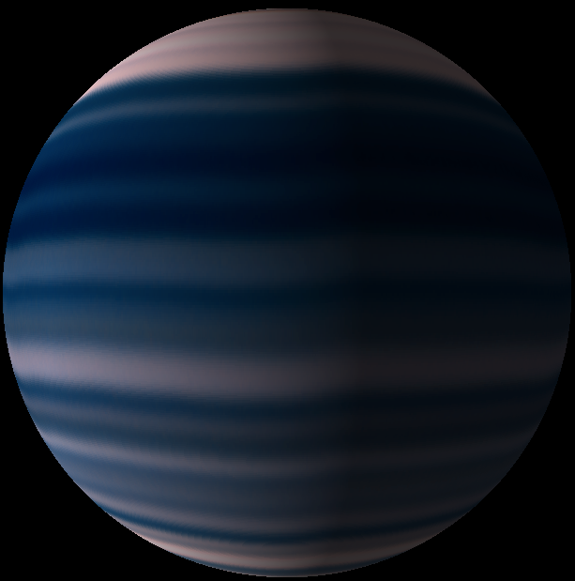
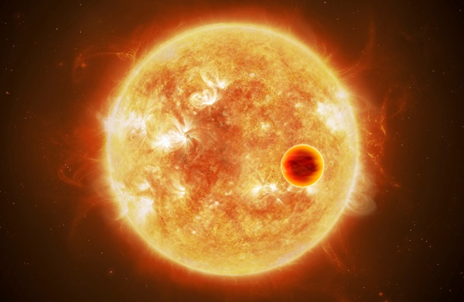
04
Limitation

Slide 15
Reference
https://iopscience.iop.org/article/10.3847/2041-8213/ac4968
https://iopscience.iop.org/article/10.3847/1538-3881/ac58fc
https://www.space.com/hubble-space-telescope-exoplanet-extreme-weather
https://www.nature.com/articles/s41586-022-04453-2

Slide 16
THANK YOU
FOR LISTENING

